Slide 1

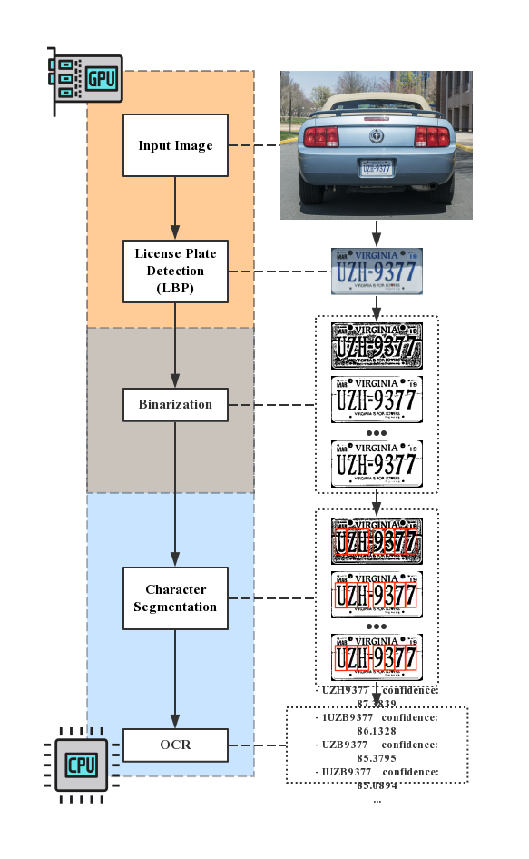
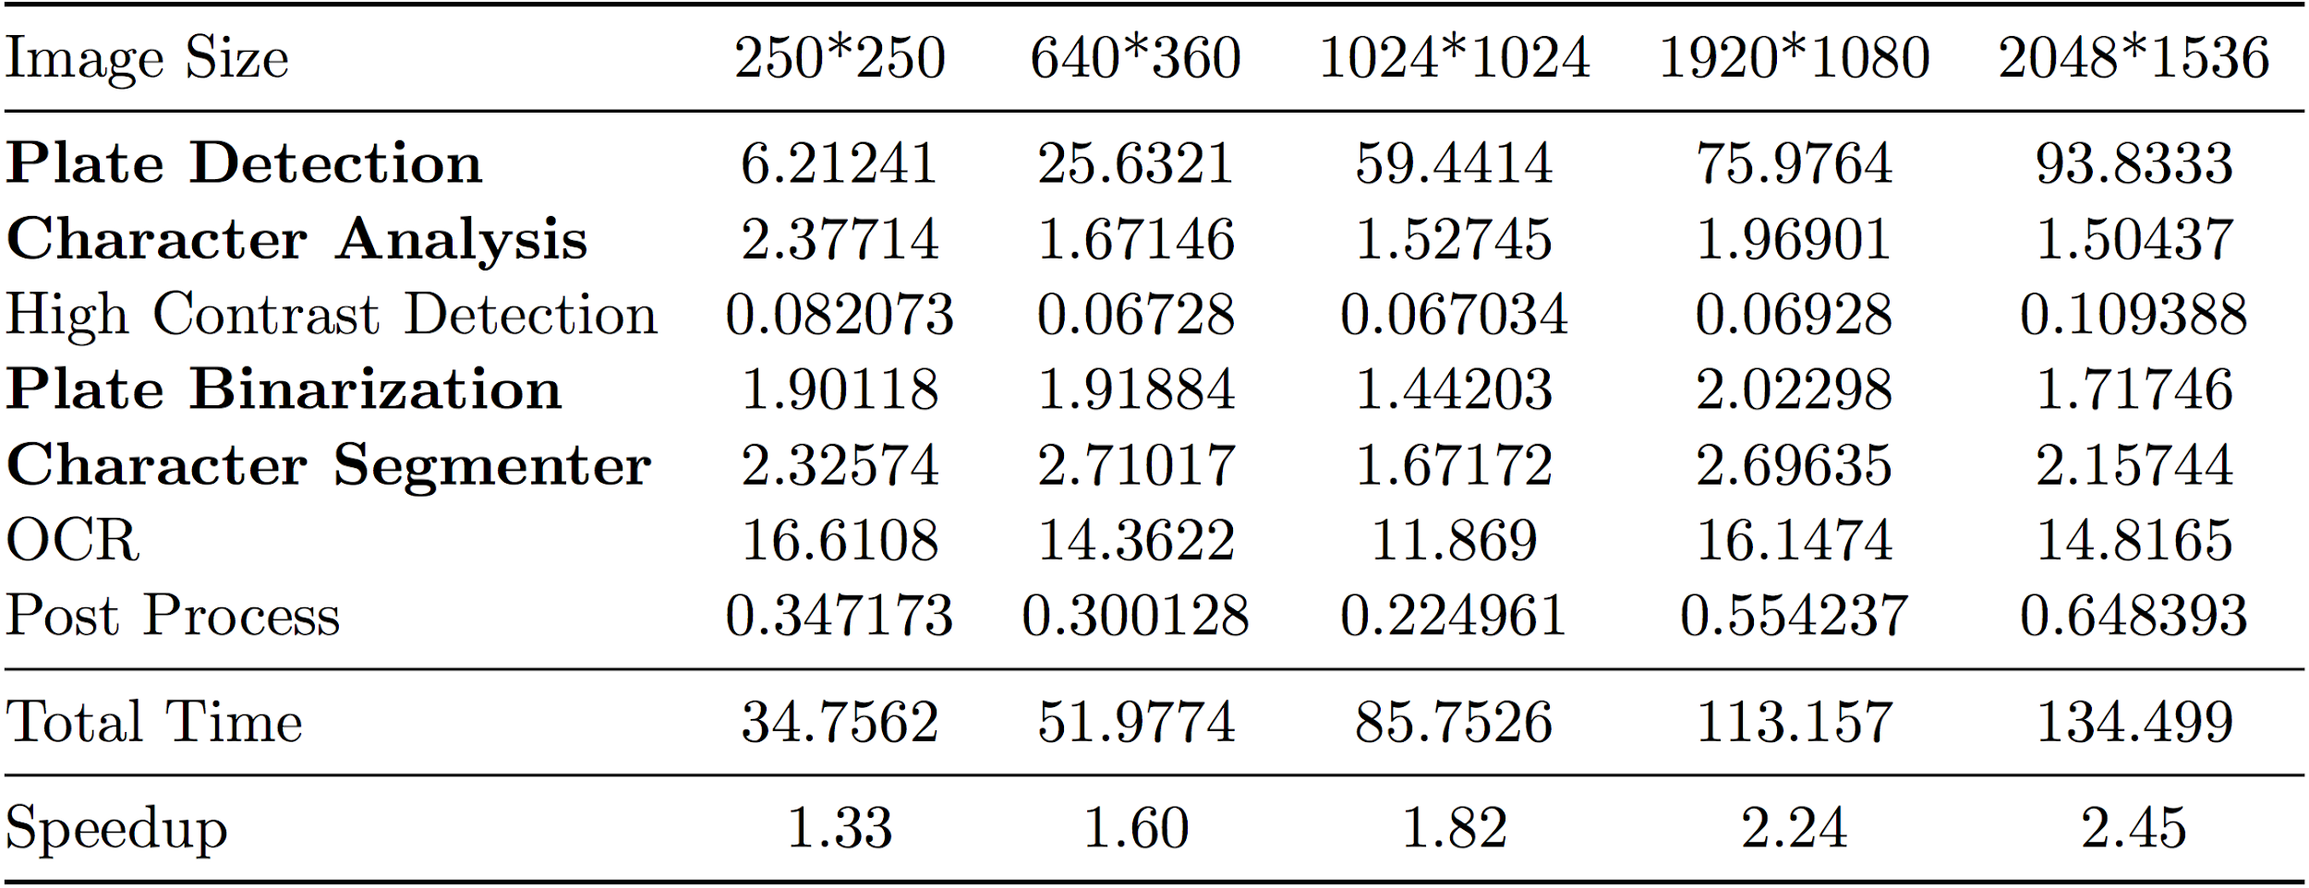
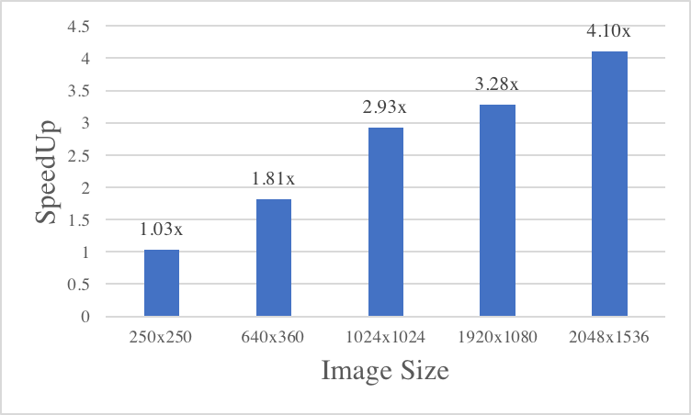
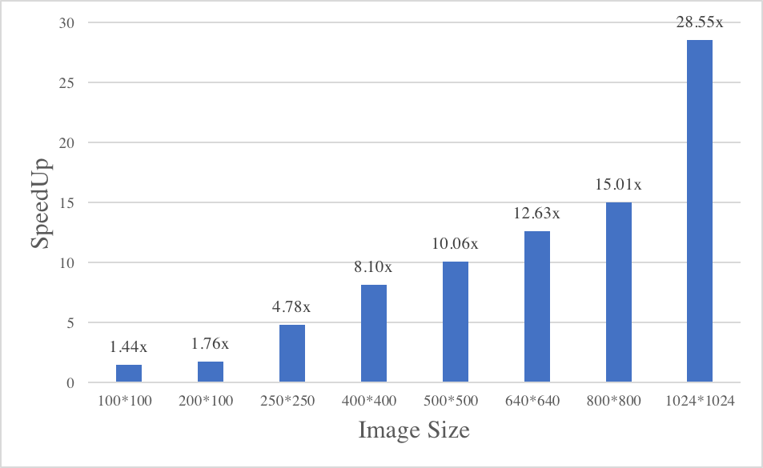
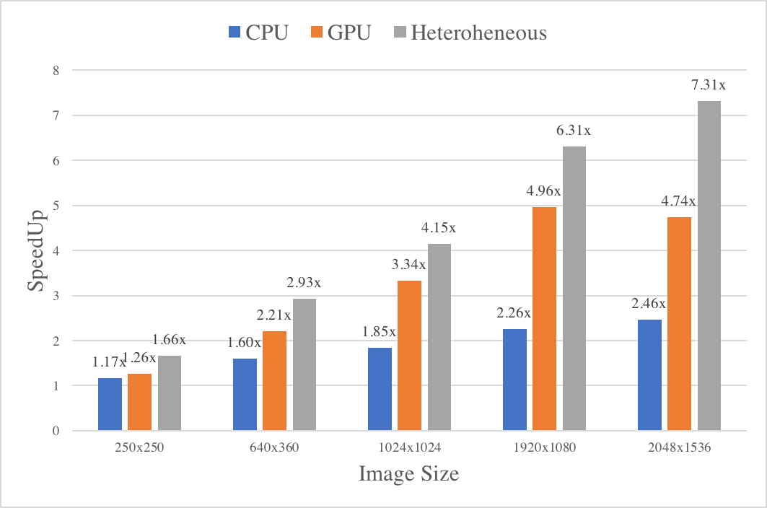
Heterogeneous Parallelized Automatic Number Plate Recognition System
Hsiaohan Chen, Yichen PAN
Carnegie Mellon University
Overview
Motivation:
Automatic number plate recognition (ANPR) is a computation intensive and latency critical application
Relative independent workload and multiple stages can benefit greatly from parallel
Problem:
Parallelize the whole pipeline on multi-core CPUs and GPUs
Integrate two parallel into one heterogeneous system that maximizes performance
Results
Multi-core CPU Parallel:
GPU Parallel:
Heterogeneous Parallel:
Time analysis of Multi-core CPU-based parallelized pipeline on GHC machine
Pipeline
License Plate Detection: LBP algorithm
Image Binarization: Sauvola algorithm
Deliverable:
1.846× speedup on multi-core CPUs
3.3351× on GPUs
4.1527× on finally integrated heterogeneous system
Future Work
Parallelize OCR stage
Use OpenCL to better parallelize on heterogenous platform
Reference
[1] Openalpr: Automatic license plate recognition library.
https://github.com/openalpr/openalpr, 2018
Notes:
‹#›

